Slide 1


HUMAN-COMPUTER
INTERACTION
Usman Institute of Technology
FALL 2021
CS411 Human Computer Interaction
Lecture 14
Evaluation Techniques

Slide 2
In Last Lecture …
Introduction to evaluation
  What Evaluation is?
  Significance and importance of evaluation
  Different paradigms
  Different techniques which constitute this paradigm

Slide 3
Evaluation
The process of systematically collecting data that informs us about what it is like for a particular or group of users to use a product for a particular task in a certain type of environment

Slide 4
In Today’s Lecture …
Framework to guide the evaluation process
Usability Testing

Slide 5
Framework to guide evaluation
DECIDE framework
6 unique phases
  Determine the overall goals that the evaluation addresses.
  Explore the specific questions to be answered.
  Choose the evaluation paradigm and techniques to answer the questions
  Identify the practical issues that must be addressed, such as selecting participants
  Decide how to deal with ethical issues.
  Evaluate, interpret, and present the data.

Slide 6
Determine the goals
What are the high-level goals of the evaluation?
Who wants it and why?

Slide 7
Explore the questions
In order to make goals operational, questions must be answered to satisfy them.
For example
  What are customers’ attitude to these new tickets?
  Do customers have adequate access to computers to make bookings?
  Are they concerned about security?
  Does this electronic system have a bad reputation?

Slide 8
Choose the evaluation paradigm and techniques

Slide 9
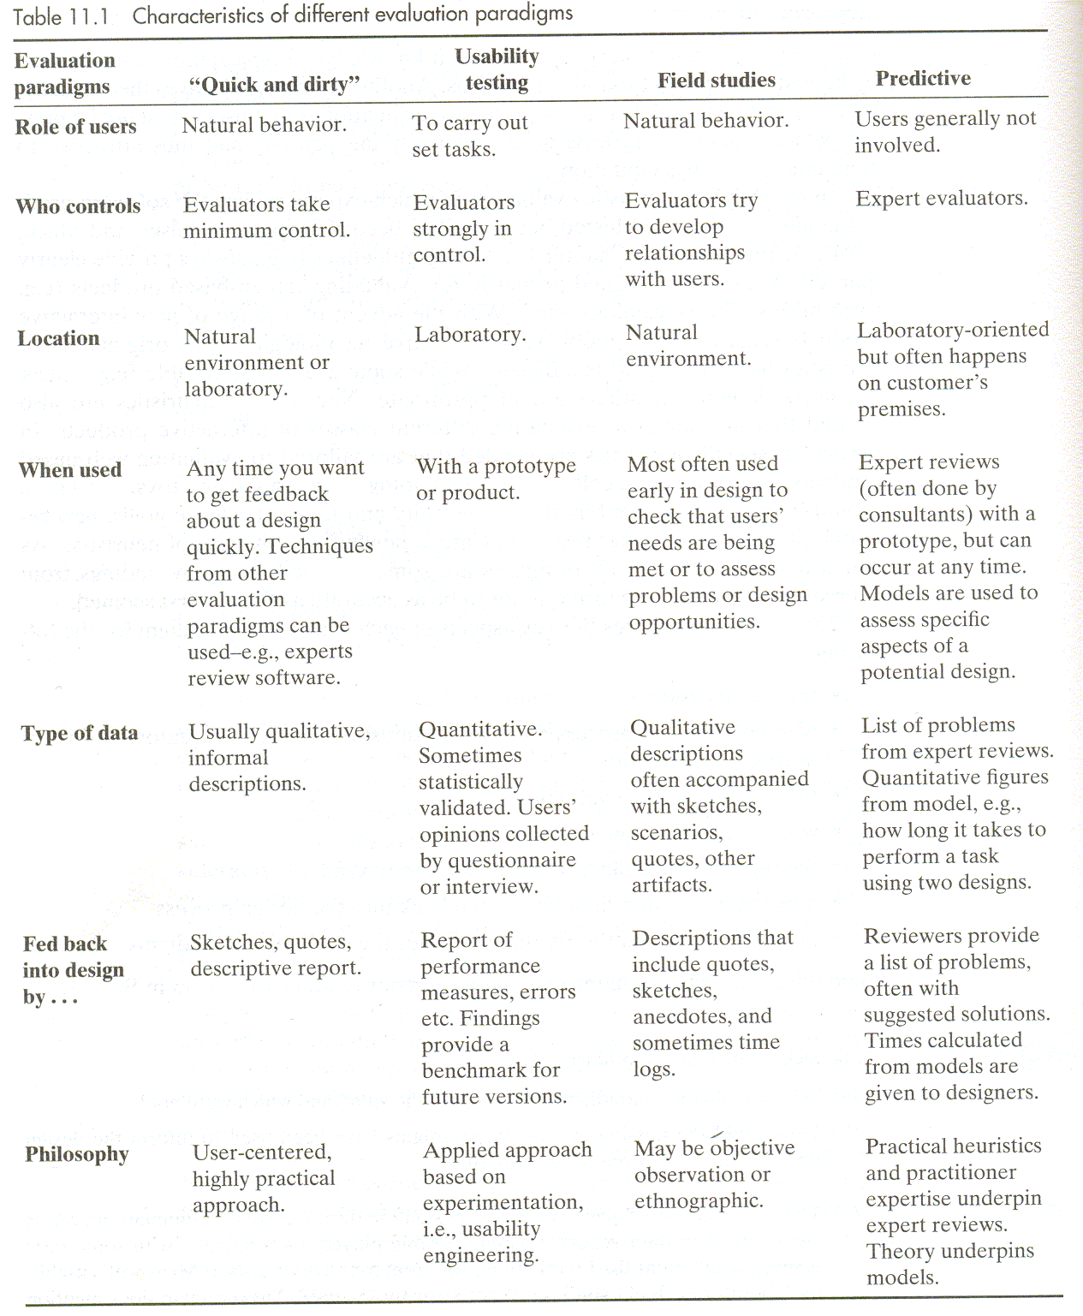

Slide 10
Identify the practical issues that must be addressed
Users and the participants
Facilities and equipment
Schedule and budget constraints
  Time and budget constraints are also important considerations to keep in mind.
Expertise
  Does the evaluation team have the expertise to do the evaluation.

Slide 11
Decide how to deal with the ethical issues.

Slide 12
Evaluate, interpret, and present the data
Reliability
  The reliability or consistency of a technique is how well it produces the same results on separate occasions under the same circumstances.
Validity
  Validity is concerned with whether the evaluation technique measures what it is supposed to measure.
Biases
  Biases occur when the results are distorted.
Ecological validity
  Ecological validity is concerned how the environment in which an evaluation is conducted influence or even distorts the results.

Slide 13
Usability Testing

Slide 14
Usability testing
Plan and Prepare for the test
  Planning the usability test
  Defining goals and concerns
  Deciding participants
  Recruiting participants
  Selecting and organizing tasks to test
  Deciding how the measure usability
  Preparing test material
  Preparing test environment
  Preparing test team
  Conducting a pilot test

Slide 15
Usability testing
Defining goals and concerns and then decide who should be the participants in the usability test

Slide 16
